Slide 1
Data Models
Introduce Common Models, Limits in “Sampling”
Basic Vector and Raster Structures
Geographic and Attribute components of features
Tradeoffs in resolution, area, accuracy, and time - all data are a sampling of geographic reality
Attributes: Nominal, Ordinal, Interval/Ratio

Slide 2
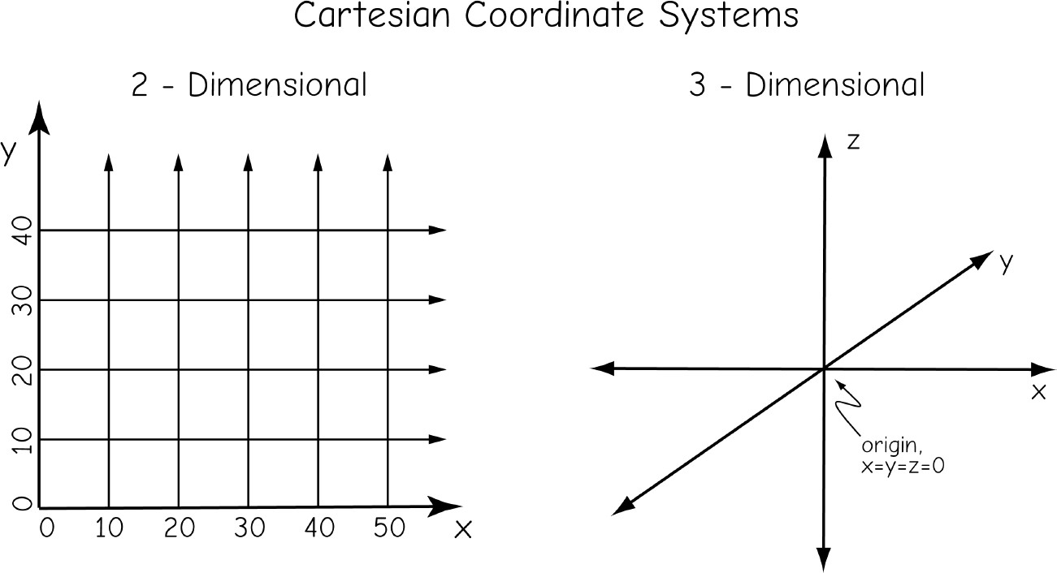
Most of Our GIS Layers Stored, Manipulated in Cartesian Coordinate Systems

Slide 3
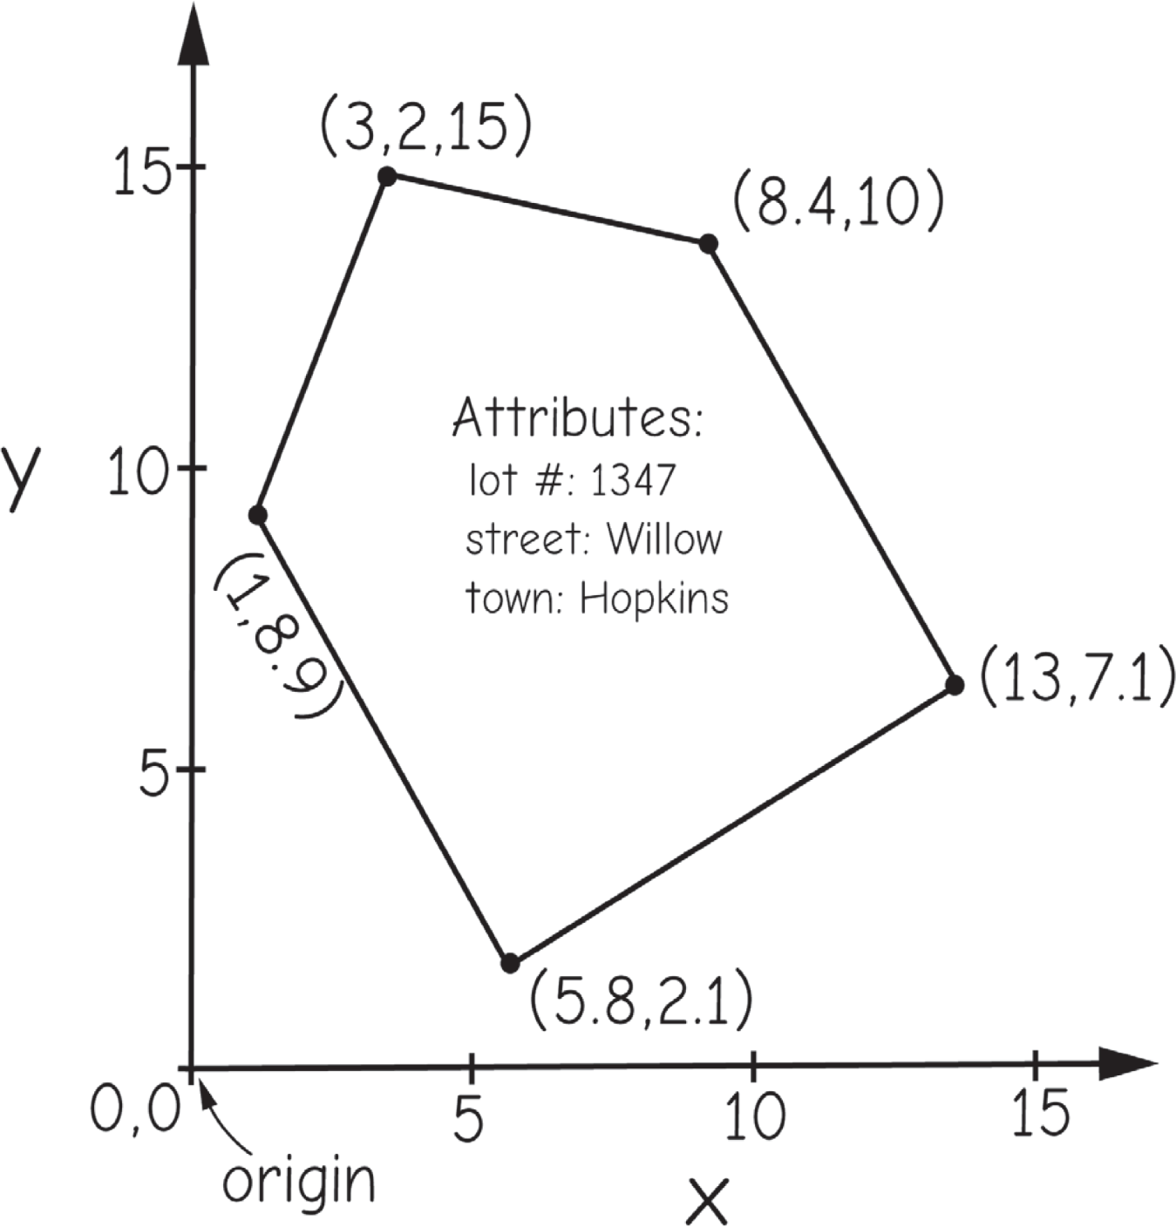
Two part data: Coordinates and Attributes

Slide 4
Two part data: Coordinates and Attributes

Slide 5
Two part data: Coordinates and Attributes

Slide 6



Two Main Data Models
Vector
Raster

Slide 7

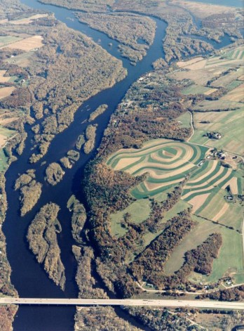
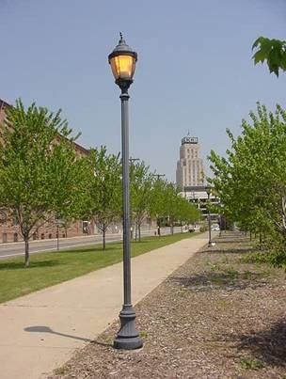


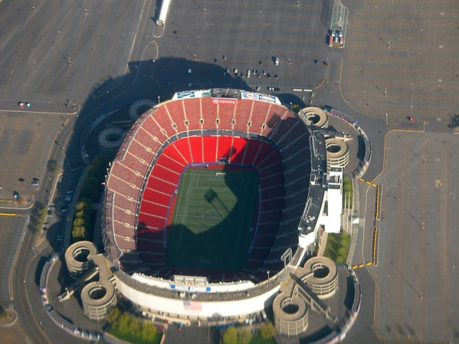
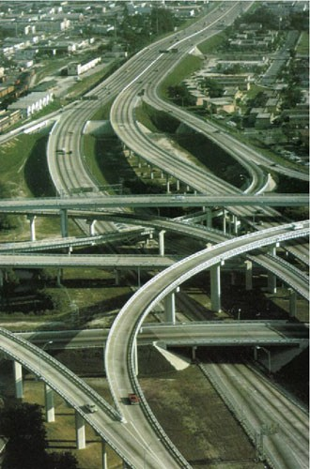
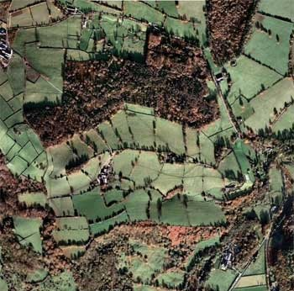
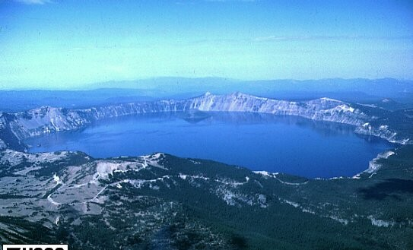
Vector Features
Points
Lines
Areas

Slide 8
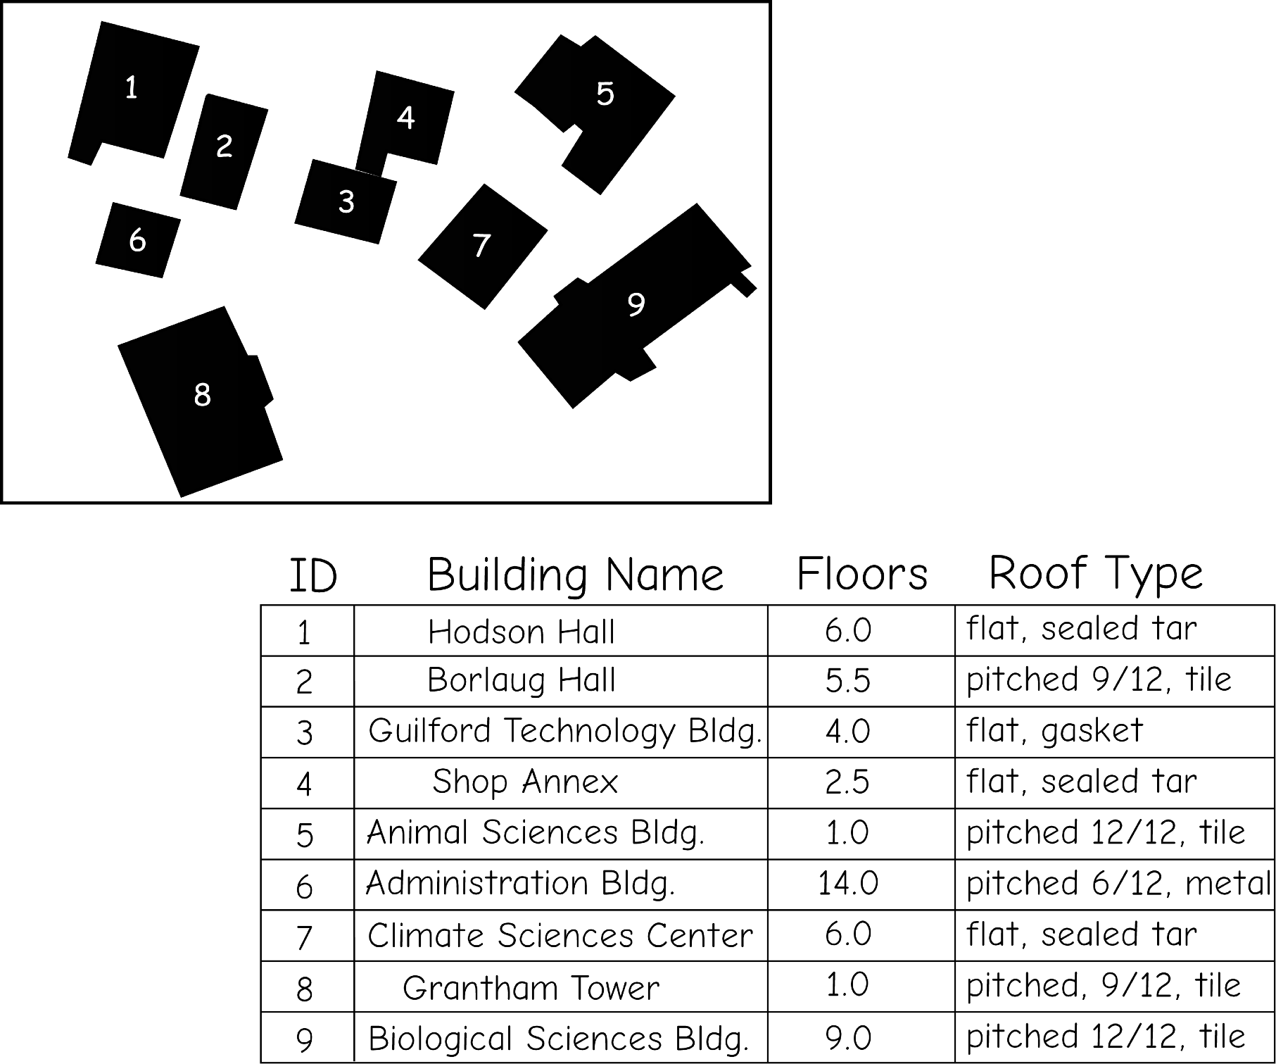
Vector Polygons

Slide 9
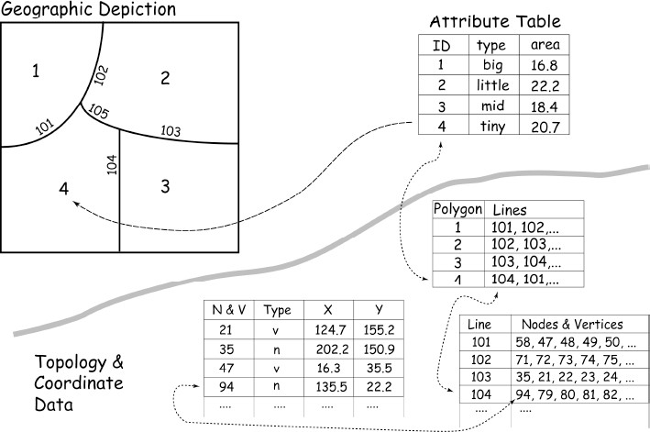
What you see
What you don’t see

Slide 10
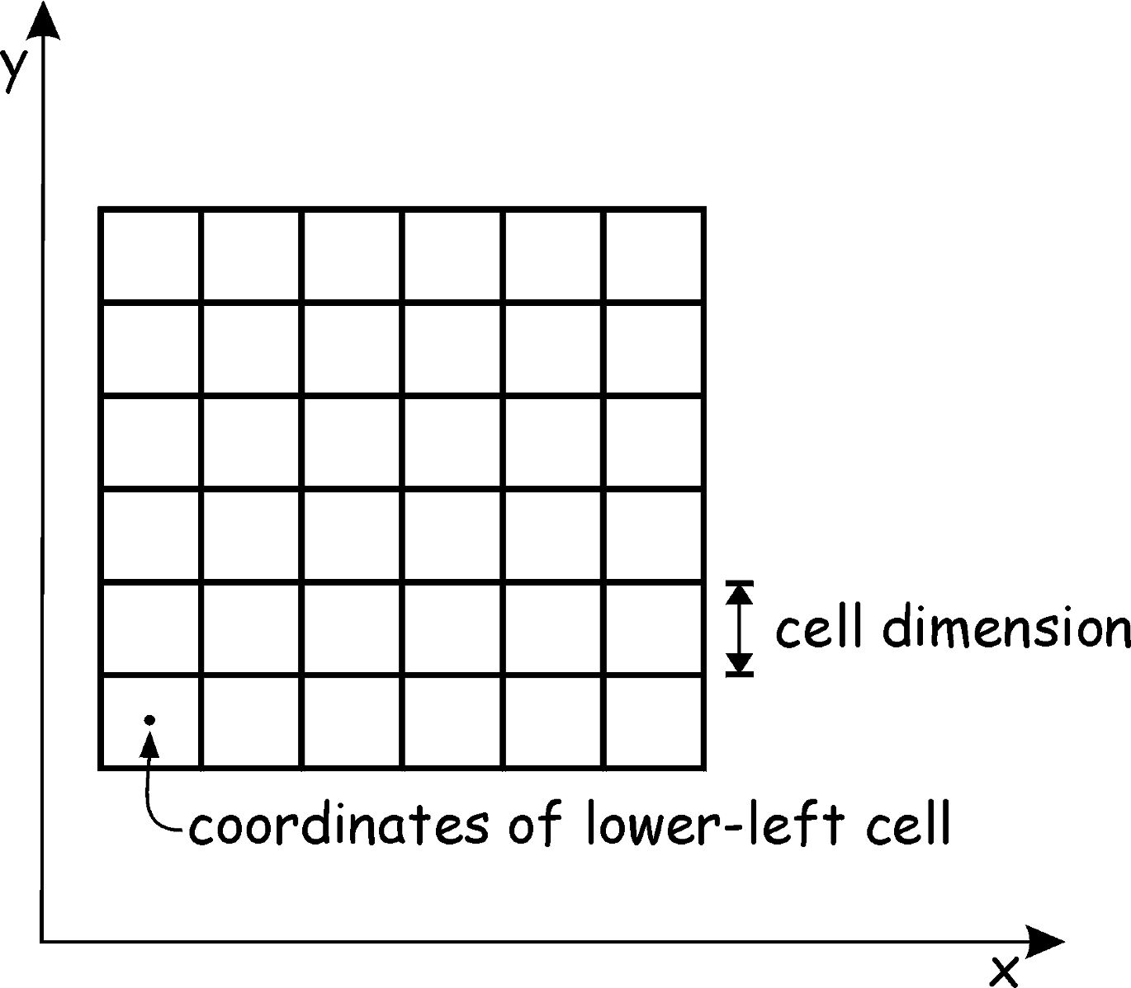
Rasters – Fixed Cell Size, Grid Orientation

Slide 11

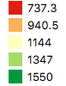
Gradients

Slide 12

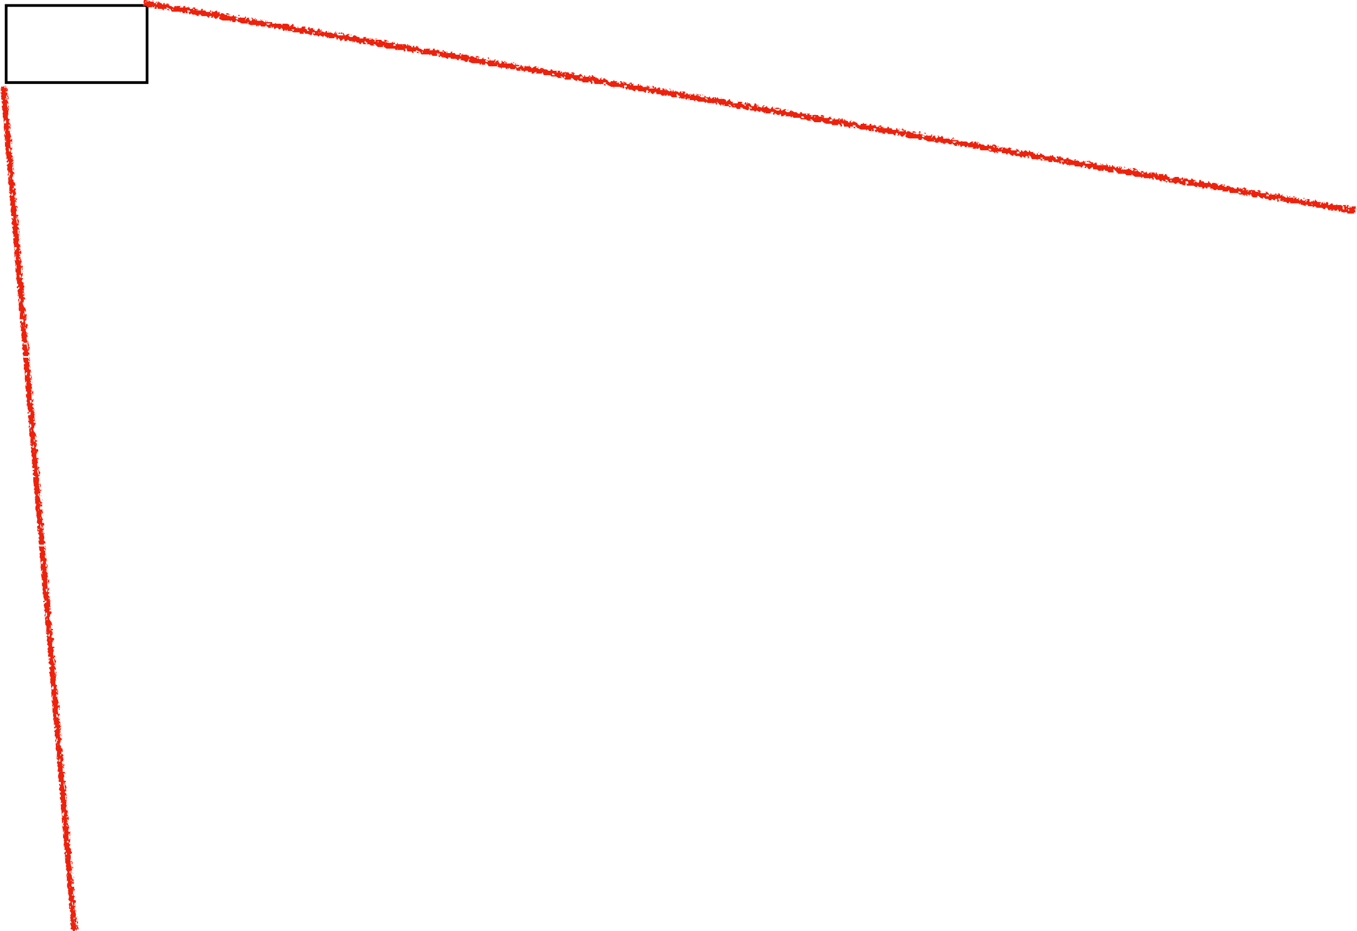

raster cells, each has a value

Slide 13
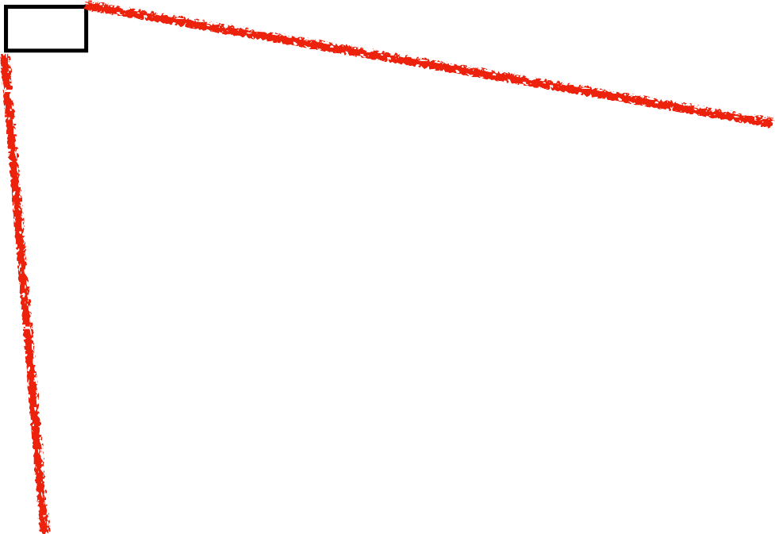

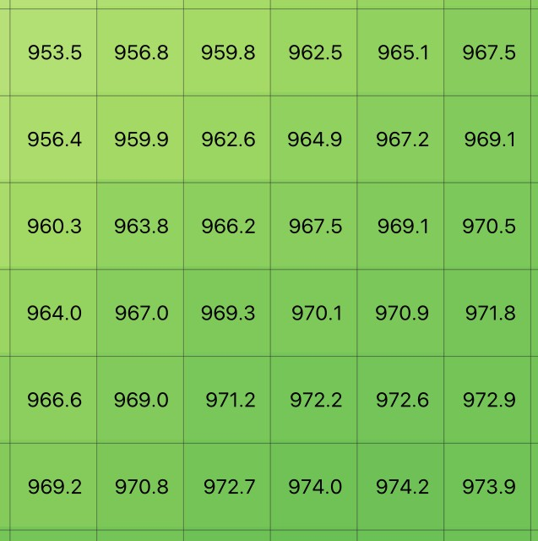
Raster cells, each has a value

Slide 14


Two key questions:
Grain size (smallest thing I want to resolve, and Extent (spatial scope of my analysis)

Slide 15
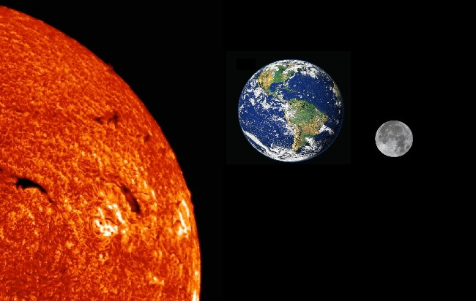
Life is often about managing expectations
Desire for this extent….

Slide 16
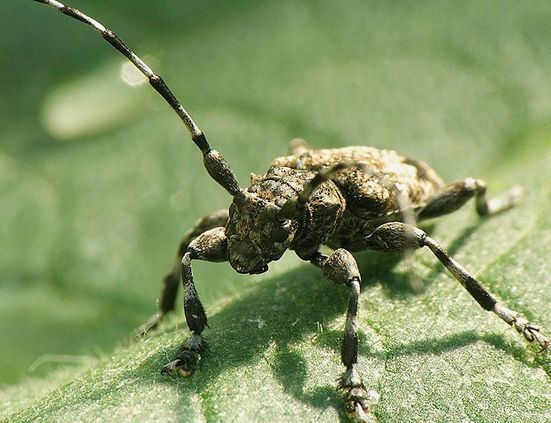
….at this spatial grain

Slide 17
What resolution (how fine scale)?
How big an area?
Data volumes
Data volumes
Fine
Coarse
Small
Large
Resolution
Area

Slide 18
Third key question: how fine a grain size can I aﬀord while meeting my accuracy targets?
Errors Often Increase with Extent, Data Costs Increase as Grain Decreases.
Data cost for a fixed accuracy
Data error
Small
Large
Coarse
Fine
Extent
Grain

Slide 19
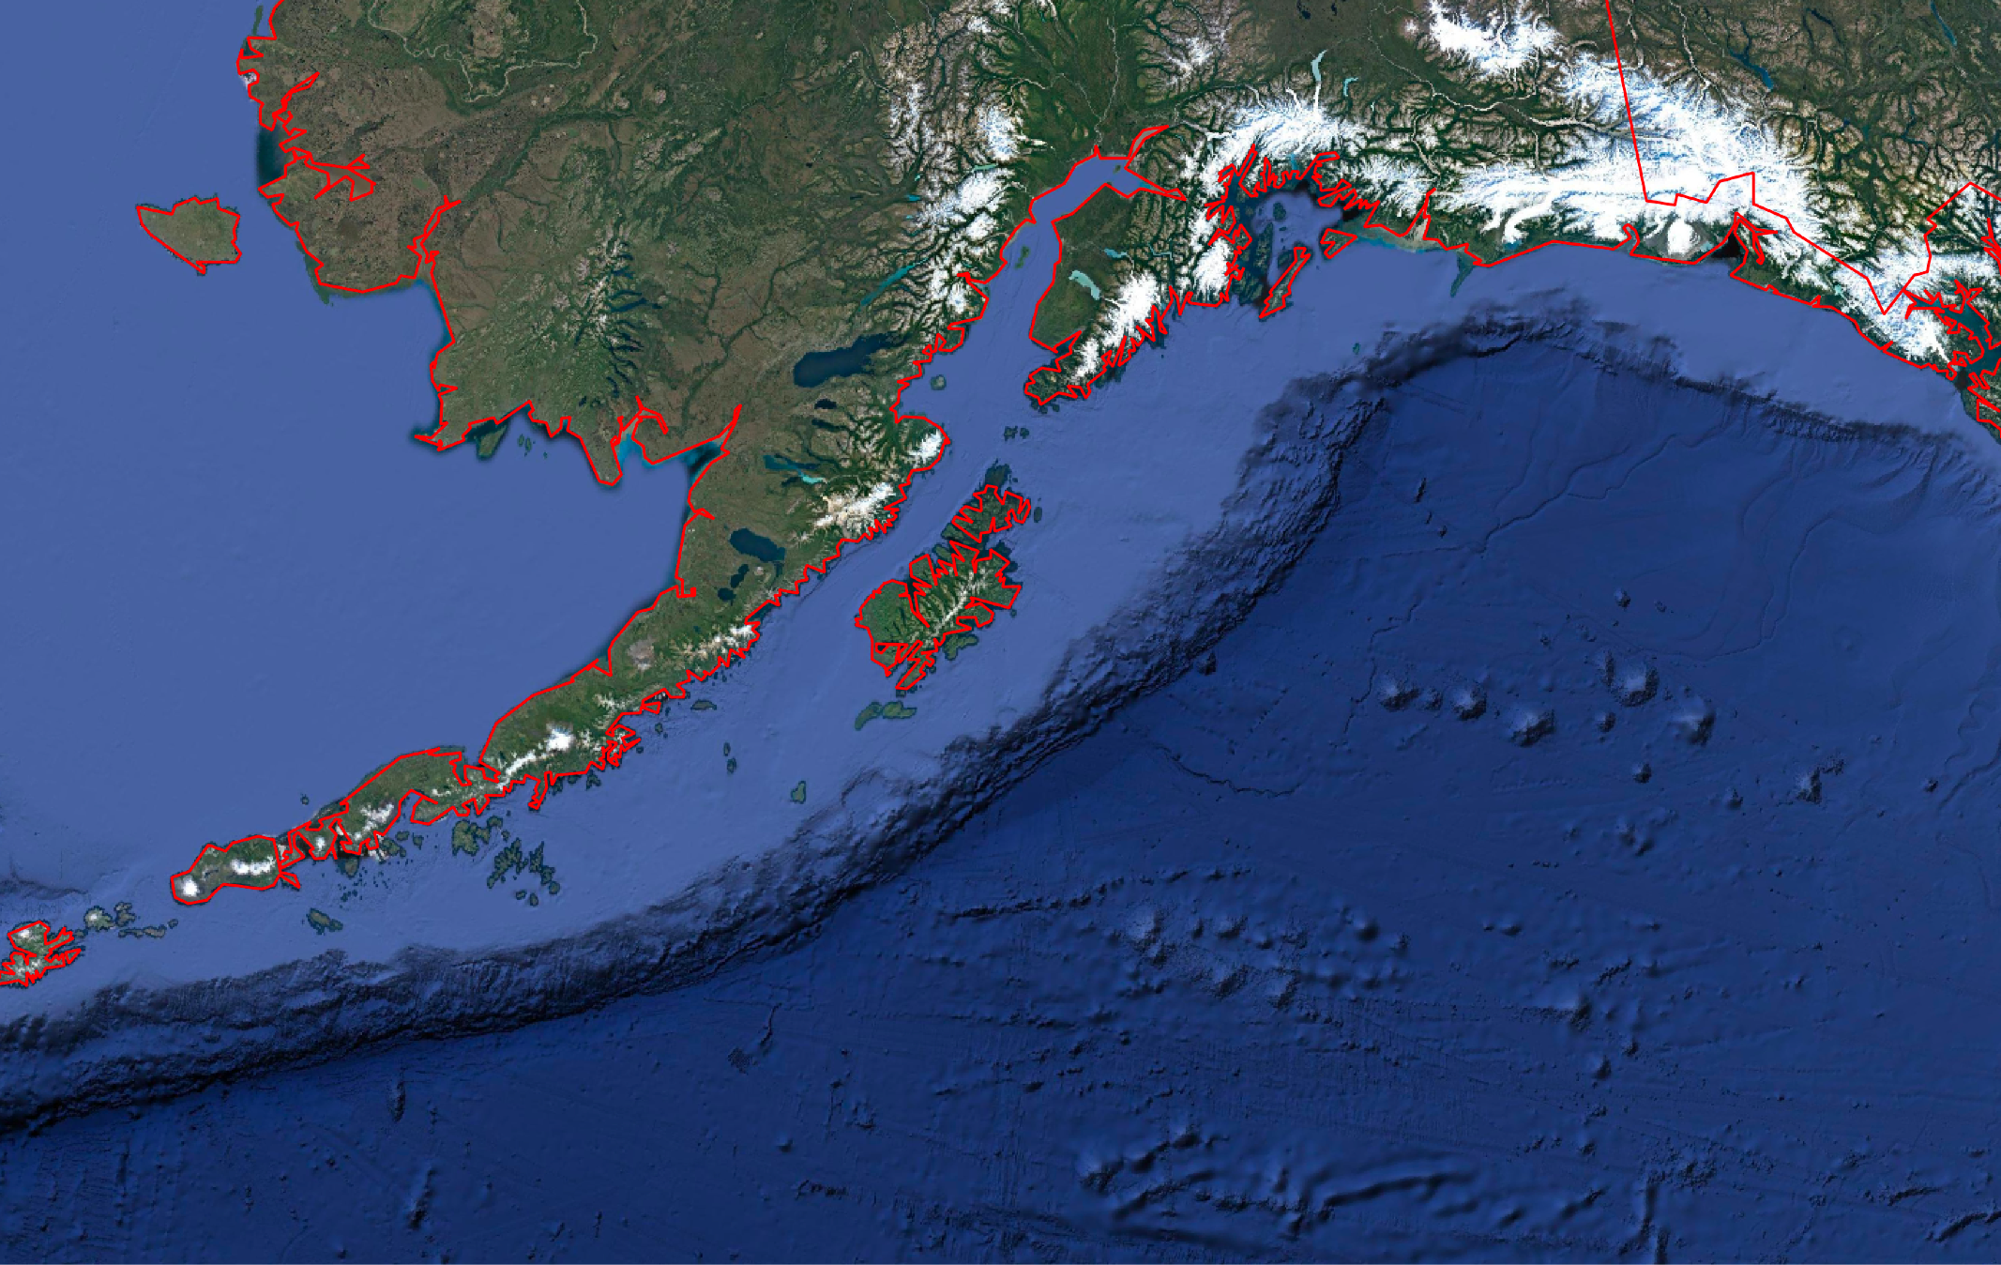
Sampling (digitizing) Accuracy vs. Cost

Slide 20
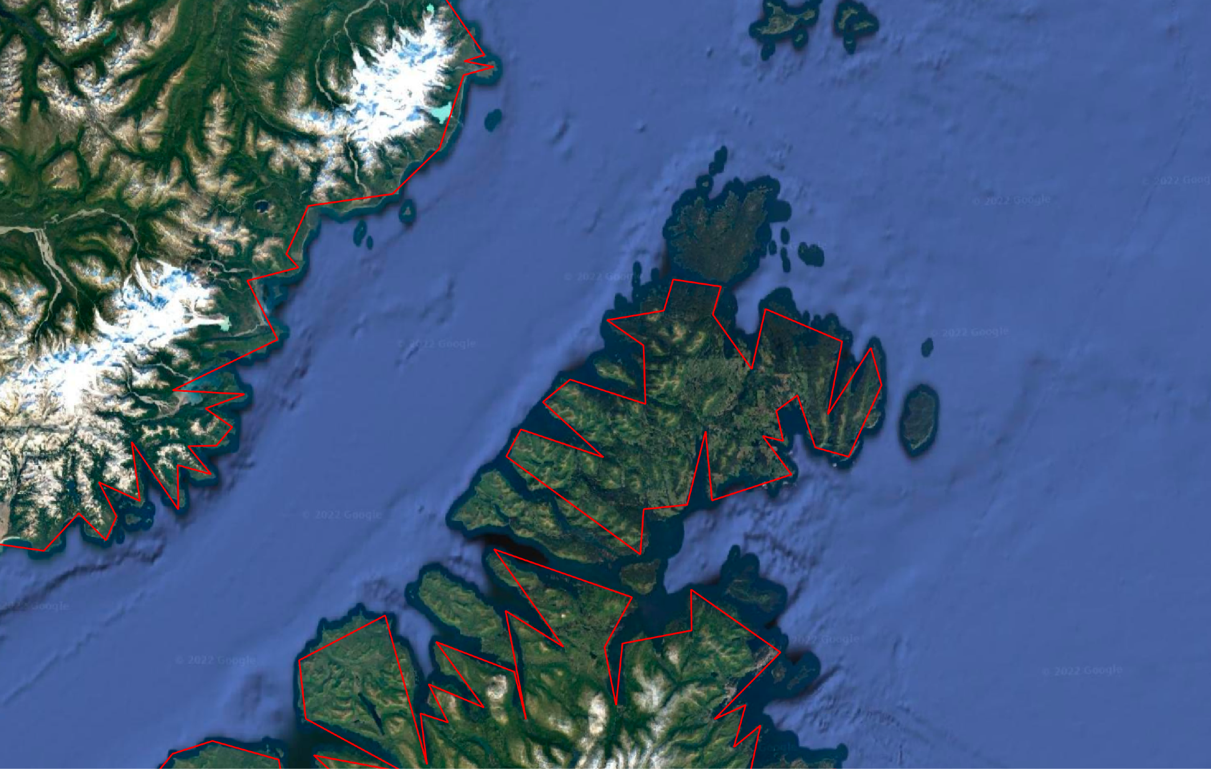
On Closer Inspection, Sampling Errors

Slide 21
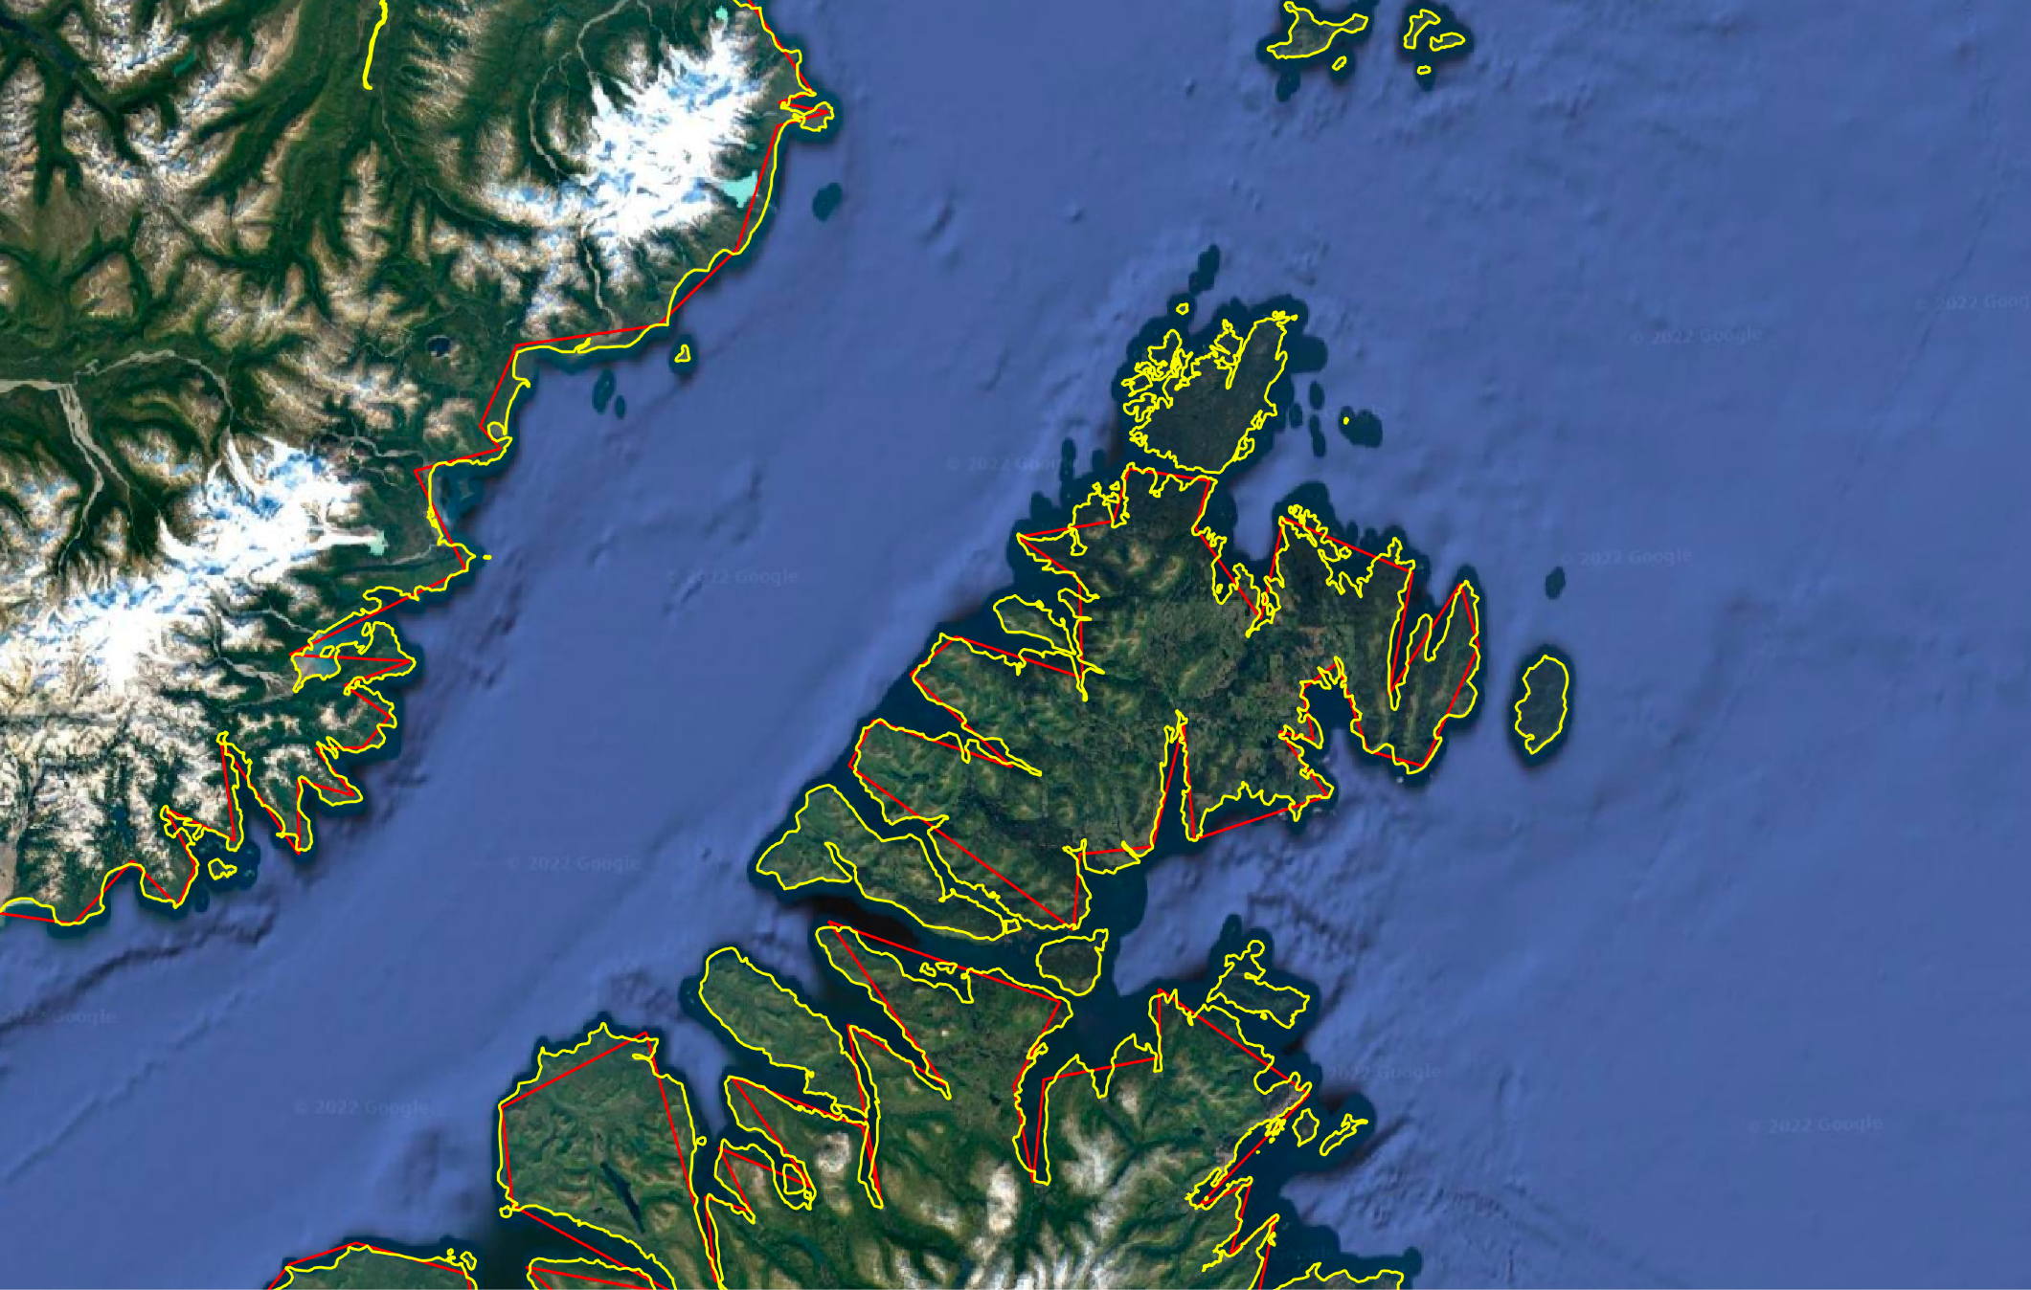
A more detailed (and expensive) sampling of vertices

Slide 22
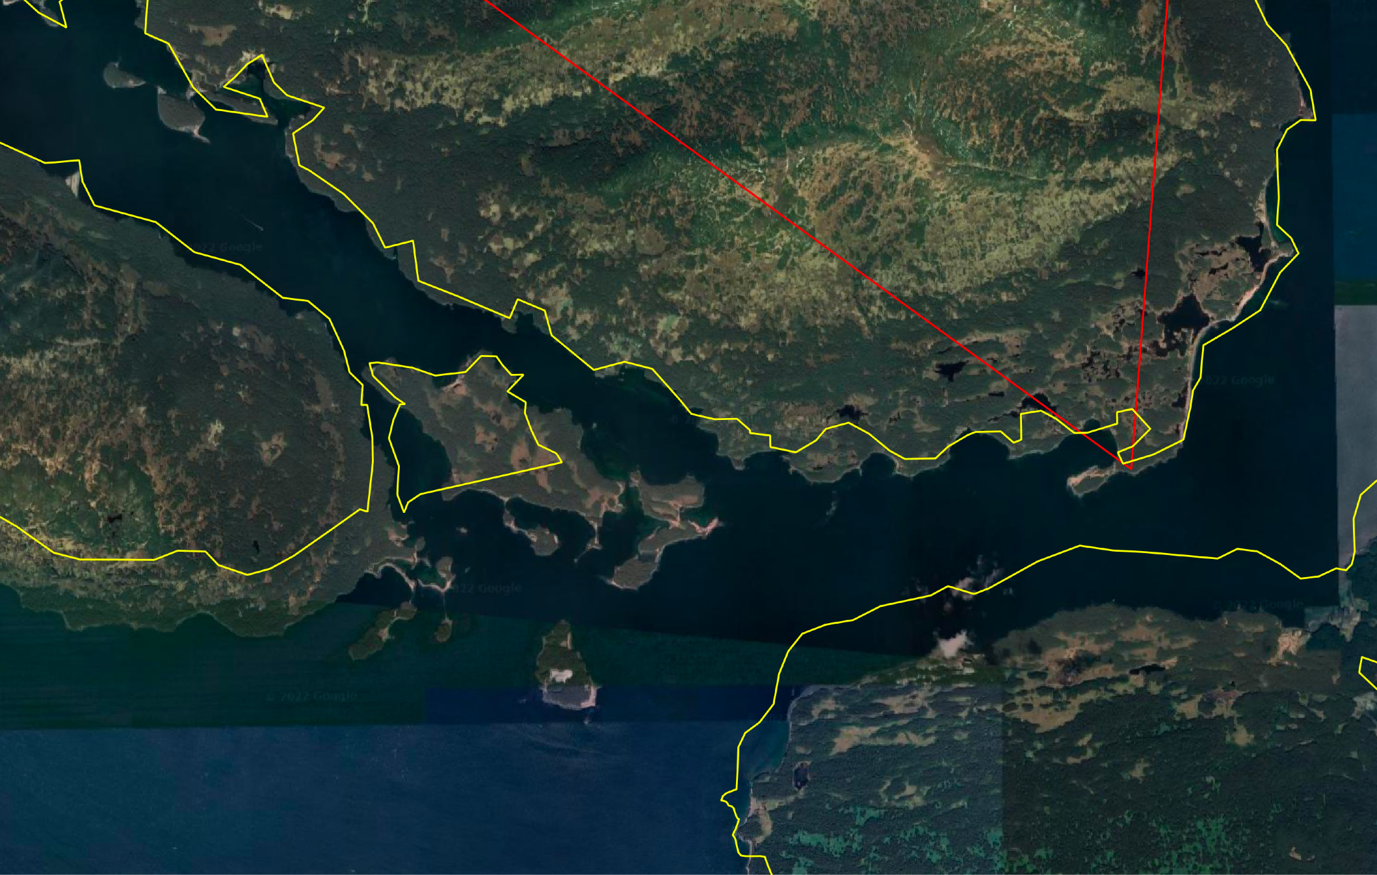
But further magnification reveals (smaller) errors are still there
Remedy: realize all data have some sampling (resolution, grain) error, ensure it is below a spatial dimension that is important to you

Slide 23
Common Attribute Types of Data, Both Raster and Vector
Nominal - no implied rank or size, e.g., county or country name,
Ordinal - identifies order, but not absolute diﬀerence, e.g., state rank by percent poverty
Interval/ratio - both order and a linear scale, e.g., temperature, pop. density, elevation

Slide 24
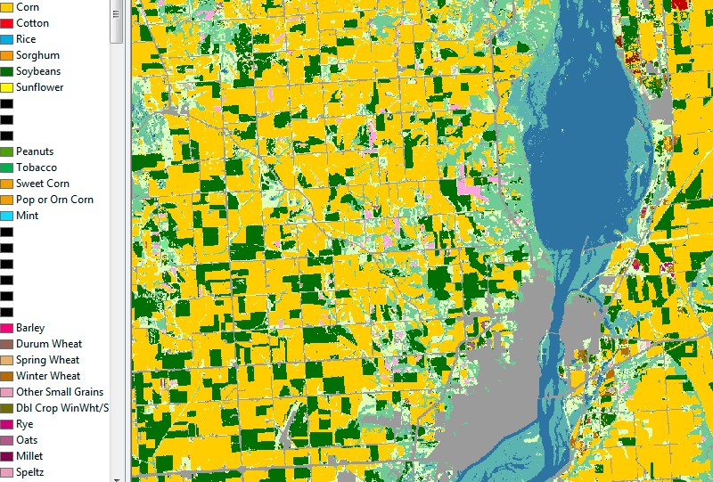
Land Cover
Nomina
l, Ordinal, or Interval/Ratio?

Slide 25
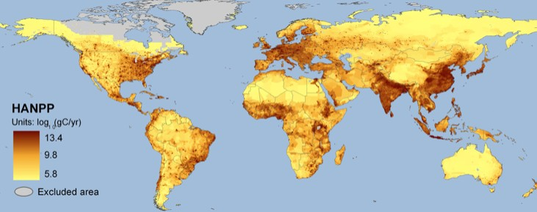
Nominal, Ordinal, or
Interval/Rati
o?
Human appropriation of net primary productivity - grams of carbon per unit area per year

Slide 26
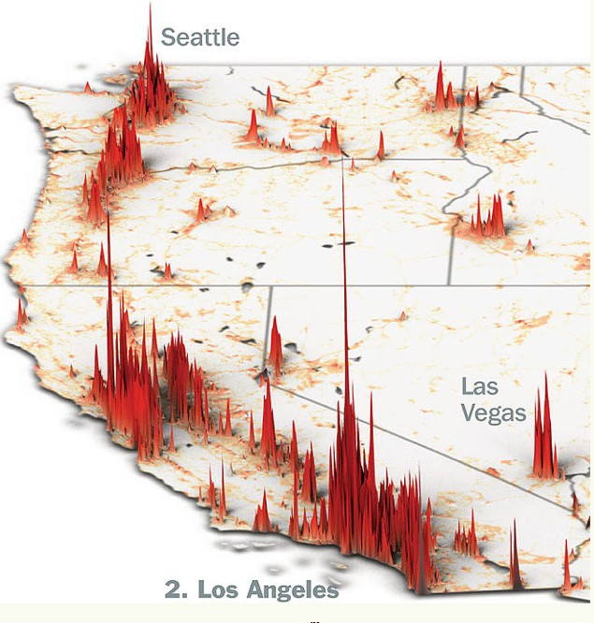
Population count, persons
Nominal, Ordinal, or Interval/Ratio?

Slide 27
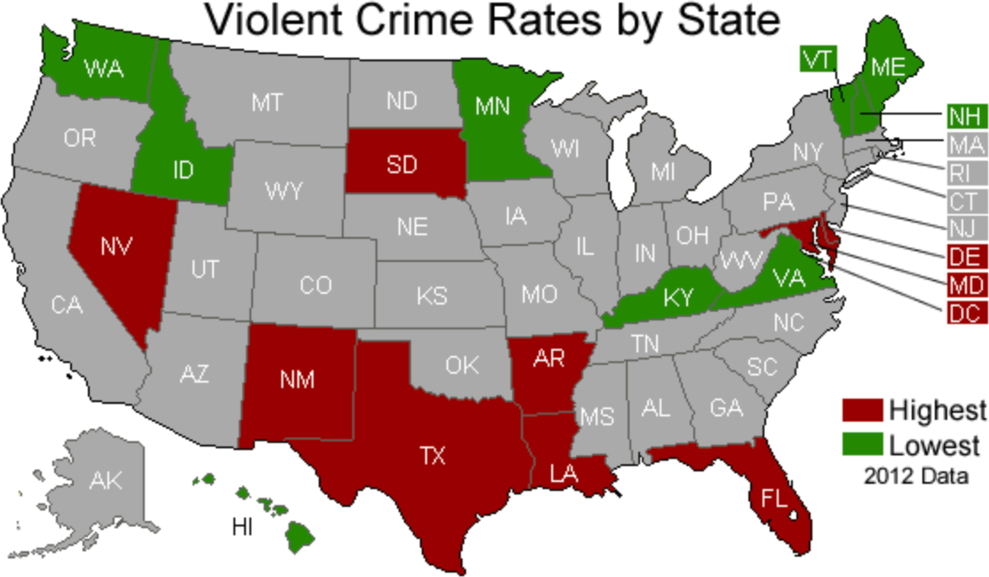
Nominal,
Ordina
l, or Interval/Ratio?

Slide 28
Data Models
Introduce Common Models, Limits in “Sampling”
Basic Vector and Raster Representation
Geographic and Attribute components of features
Tradeoffs in resolution, area, accuracy, and time - all data are a sampling of geographic reality
Attributes: Nominal, Ordinal, Interval/Ratio

